Slide 1


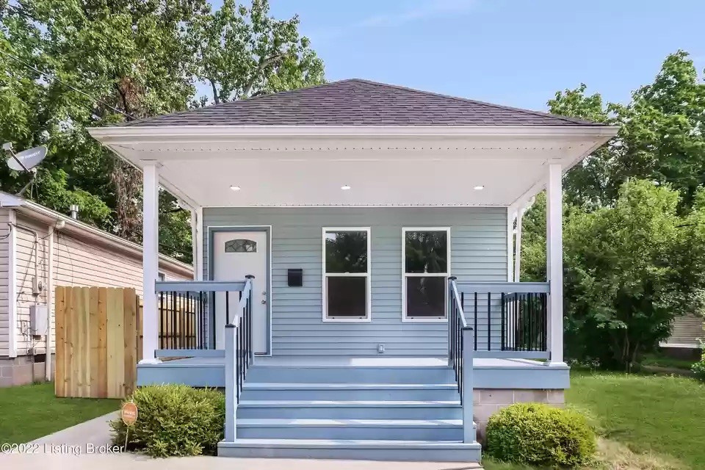








Introduction to the REVERT Program

Slide 2

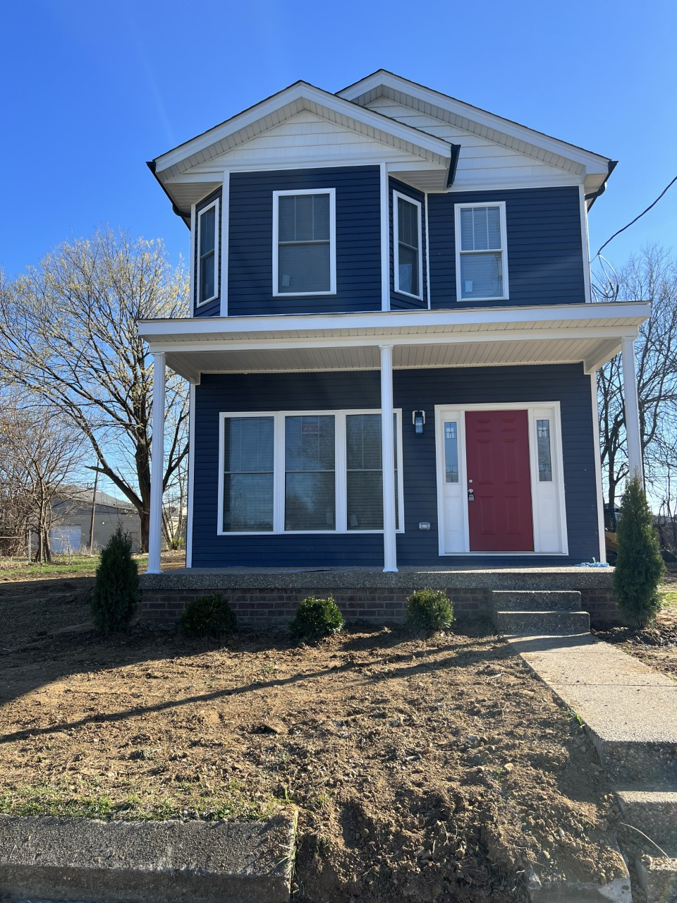

TABLE OF CONTENTS
    What is the REVERT Program?
    Eligibility Requirements
    REVERT Program Process
    Guidelines to Remember
    Real Estate Agent Guide
    Contact Us

Slide 3

What is the REVERT program?
Louisville Affordable Housing Trust Fund’s Redlining Mitigation program known as REVERT is an acronym for Restoring Each Viable Economically Redlined Territory. REVERT strives to provide homeownership opportunities to families disproportionately impacted by Redlining in previously redlined neighborhoods. Many of these neighborhoods overlap Covid-19 affected areas. Through funding and resources, we plan to prioritize these efforts on undervalued, abandoned, and vacant properties.
The REVERT program will provide 216 families with up to $50,000 in rehabilitation funding towards a home purchase. The funds can be used towards updating a property for code compliance, enhancing energy efficiency, updating décor and interior designs, as well as enhancing the curb appeal of a property. The funds may be used to demolish a structure, clear the lot, and build a new structure on the site. All construction MUST adhere to FHA guidelines of required repairs. The funds are forgivable if the applicant owner occupies the home for at least 15 years. The applicant and the home must be eligible to be approved for funding. The selected property must be in a previously-redlined area and steps will be taken to validate that the applicant has family lineage tied to a previously redlined area.

Slide 4




Eligibility Requirements
  Proof of family lineage that a direct family member resided in a previously Louisville Metro redlined area between 1937-1968. Eligible family members include the applicants' mother, father, grandparents or great grandparents.
  Based on the applicant's household size, the applicant’s income can not exceed 300% of Federal Poverty Guidelines. Applicants must submit 2 years of income tax returns and their 2 most recent paystubs. Documentation will need to be submitted showing proof the household members currently occupy the applicant's residence.
  Each applicant must provide a valid HUD approved homebuyers education course certificate.
  The applicant must owner occupy the residence

Slide 5

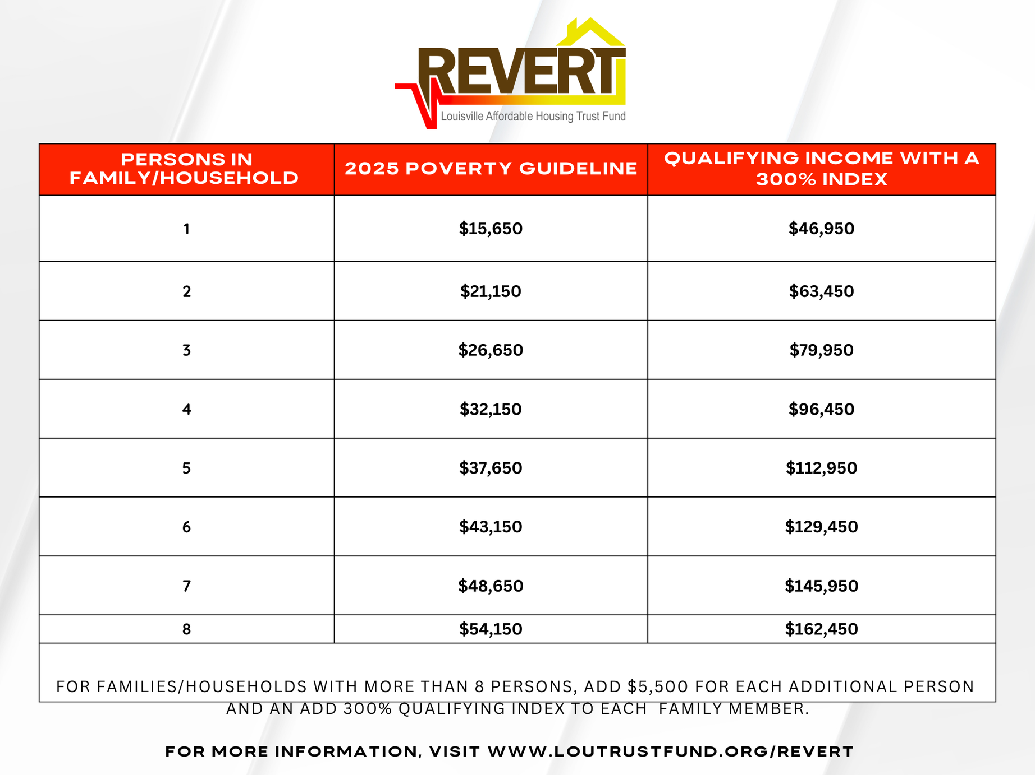

Slide 6
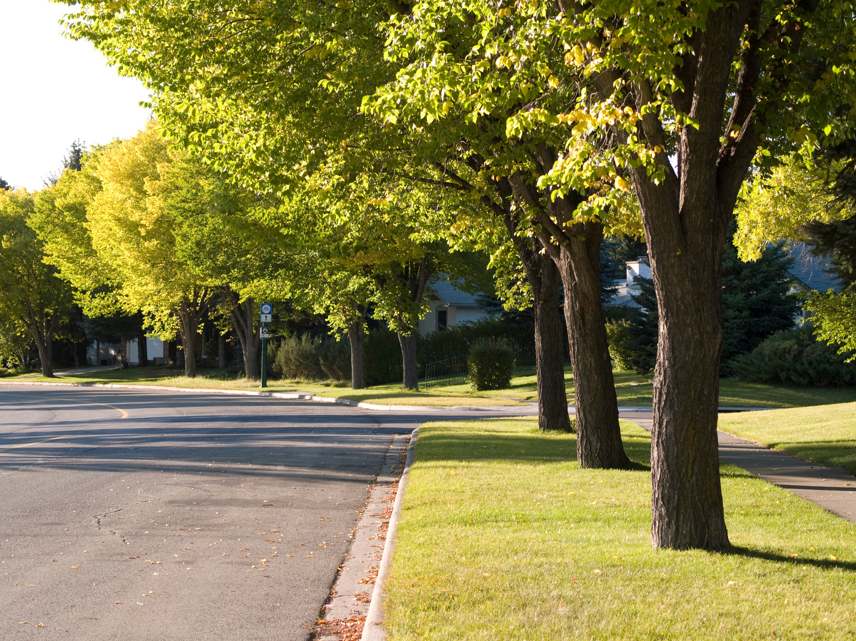
Stage One
    The applicant must complete an application using our online portal at https://portal.neighborlysoftware.com/LOUTRUSTFUND/Participant
    The applicant must list all members of their household income if applicable, and provide supporting income documentation. Any household member whose income is provided must attach their (2) most recent paystubs and (2) most recent tax returns.
    The individual who plans to apply for the mortgage must be listed as the primary on their application.
    Revert applicant’s have access to financial health services through a partnership with Apprisen. LAHTF will pay a one-time portion of each of the financial health services and applicants will receive a discounted rate for First Time Homebuyer Workshop. https://www.apprisen.com/services/#services
      HUD approved First Time Homebuyer Workshop – $30
      Credit Health Education Session – $25 of $65 single, $25 of $85 joint
      Financial Health Plan - $25 of $75
      Financial Coaching $100 of $300
    Through the Filson Historical Societies Membership For All Program applicants can begin collecting documentation by phone or in person on an eligible family member who lived in a previously redlined area. Eligible family members consist of a parent, grand parent, great grand parent or the applicant depending on their age. The Filson will provide applicants access to their family lineage by providing free research access to the Filson’s library and reduced remote research. https://filsonhistorical.org/revert/

Slide 7

STAGE TWO
    The Client Relationship Manager will vet the application to verify all documentation is accurate and up to date. The Client Relationship Manager will approve the application or request the applicant to provide further documentation through a task in their application.
    Revert eligible applicants will move forward to Section E of the application portal. Section E allows applicants to begin attaching mortgage preapproval letters, executed real estate contracts, and home inspection reports.
    IMPORTANT NOTE – It is recommended to request a 21-day due diligence inspection period to allow ample time for inspections. After receiving an executed contract on a home please attach the contract to your application and notify your Client Relationship Manager.
    Home Inspection Process
      Home inspection only – Client or Real Estate Agent will provide Client Relationship Manager with a copy of the home inspection and the signed notification of repairs agreement.
      Louisville Metro Down Payment Assistance – The client must complete their home and DPA inspections. All inspection reports including the signed notification of repairs agreement must be shared with the Client Relationship Manager.
      LMHA Section 8 Homeownership Program – The client must complete their home inspection and send the report to their case agent. The repair list created by LMHA must be completed by the seller prior to closing.
    The Makeover Homes HUD consultation will be ordered, and the consultant will review all reports.

Slide 8

Stage Three
    The HUD consultant will contact the homeowner to schedule an initial site inspection. The consultant is in place to help the client navigate the renovation process.
    The consultant will review major & repair type defects from the home inspection, FHA minimum property standards, the age of the roof, HVAC and water heater systems.
    The required repairs will vary for each home allowing for applicants to add “client request” to their work write up if the budget allows.
    Each applicant is eligible for up to $50,000, including a 10% contingency for unforeseen issues and inspection fees.
    The work write up will be provided to the applicant to share with vetted Revert general contractors. The applicant is encouraged to submit (2) bid estimates to allow for a comparison of pricing. Ultimately the applicant will choose (1) general contractor to work with.
    The selected general contractor will submit their cost estimates to the Makeover Homes app separated into labor and materials.
    Makeover Homes consulting will create the Specification of Repairs (SOR) that must be signed by the applicant, general contractor, and the HUD consultant.
    The Specification of Repairs will serve as the road map for the applicant and general contractor. During the renovation, changes or unforeseen issues may arise. A change order must be submitted and approved by all parties before the work begins.
    After receiving the signed SOR, the mortgage lender, Revert staff, and real estate agents can begin coordinating a closing date.
    IMPORTANT NOTE – The REVERT staff must receive a completed SOR before closing. If the 1st mortgage closes prior to signing the SOR it is no longer eligible for REVERT.

Slide 9
REVERT Program Guidelines to Remember
    Revert funds can only be used for renovation, improvements, and/or construction funds of a new home purchase
    Revert funds cannot be applied toward a property that the applicant currently owns
    Applicant must be a resident of Jefferson County
    Applicant cannot currently own a home
    Applicant or someone in their direct family lineage must have previously resided in a Louisville Metro redlined area sometime between 1937-1968
    Applicant’s current income must be within 300% of Federal Poverty Guidelines
    The Revert funds are a soft 2ⁿᵈ mortgage, forgivable after 15 years if the owner occupies the home. If the owner does not follow the program guidelines the funds can be recaptured.
    Applicant must provide HUD-certified Home Buyer Education certificate
    Applicant must provide a pre-approval from a mortgage or a banking institution
    The purchase contract must list intentions to utilize Revert funds in the provision section
    Allow at least 21 days for due diligence-inspection period on purchase contracts

Slide 10
Real Estate Agent Notes
    The REVERT program is beneficial for the buyer's and the seller's agent.
      The buyer’s agent could provide information on which homes could be purchased in the REVERT area and how their client could add value to the property using the REVERT funds.
      The Seller’s agent could confirm the property is in a REVERT eligible area and use the program as a marketing tool in their description of the home.
    If your client plans to use REVERT funds it is good practice to confirm their mortgage lender is capable of closing with a REVERT mortgage.
    During the tour of potential homes with your client pay close attention to the major line items that the REVERT funds could be allocated towards. Items like the roof, gutters, HVAC system, water heater, and plumbing are typically larger priced items.
    Confirm with your client or Client Relationship Manager that the applicant has signed their family lineage affidavit and received an approved application.
    Notify the Client Relationship Manager of an accepted contract as soon as possible.
    During the applicant’s inspection period, the Client Relationship Manager will need a copy of the home inspection report, and the signed seller’s repair request. Applicants approved for DPA funding or Section 8 homeownership assistance must complete their inspections first.
    The signed Specification of Repairs (SOR) document must be received by the REVERT staff prior to scheduling a closing.

Slide 11

Let's Partner!
Contact us today
Apply at:
www.loutrustfund.org/REVERT
Call us at:
502.212.1662
Email us at:
Info@loutrustfundlou.org

